Slide 3
The Joy of Giving
“In a situation where there are islands of abundance in the sea of poverty, let us join hands to make this world a better place to live.”

Slide 4
The Joy of Giving
Sankalp organized a donation event at Mohan Nagar area, Adityapur
Clothes (summer and winter) which were donated by students of NIT Jamshedpur and our well wishers from across the city (Spouses of Tata Steel employees) were distributed to the children and their parents
The event takes place regularly where we intend to take out the surplus from the society and distribute it to the needy ones.

Slide 5
Clothes donation event at Mohan Nagar, Adityapur

Slide 7
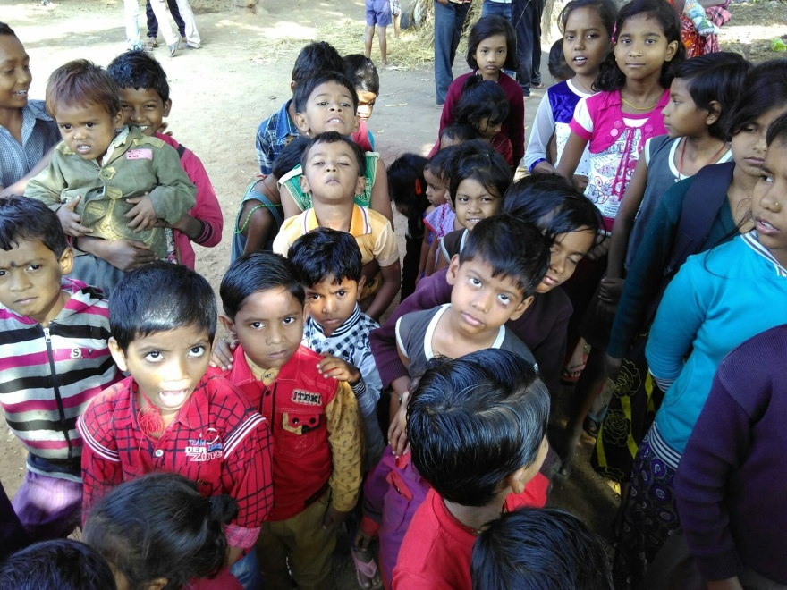
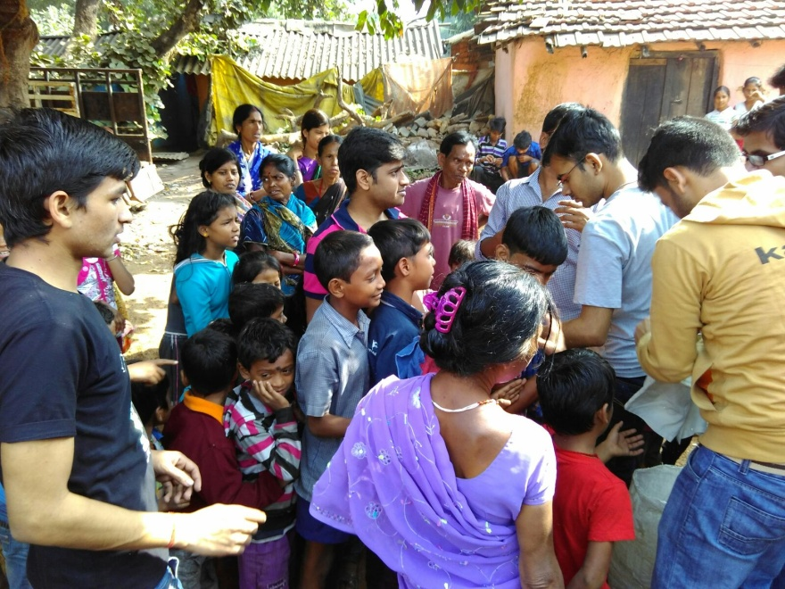
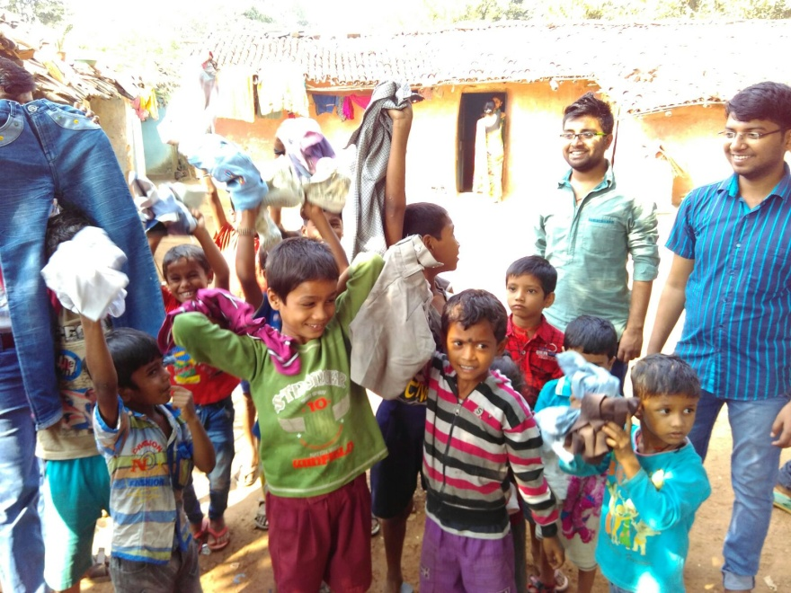
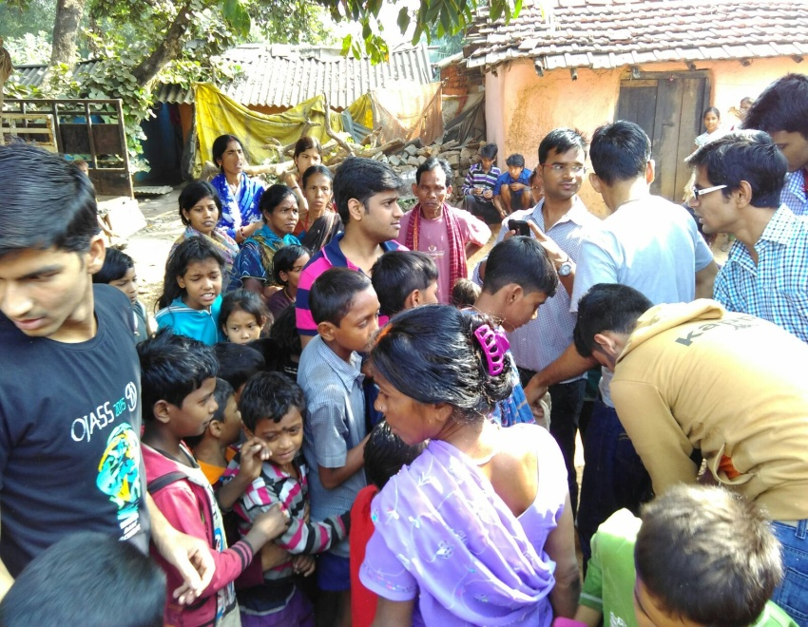

Slide 8
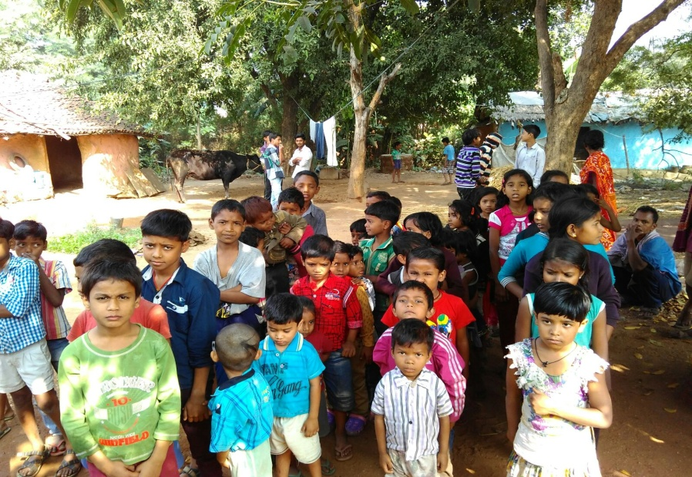
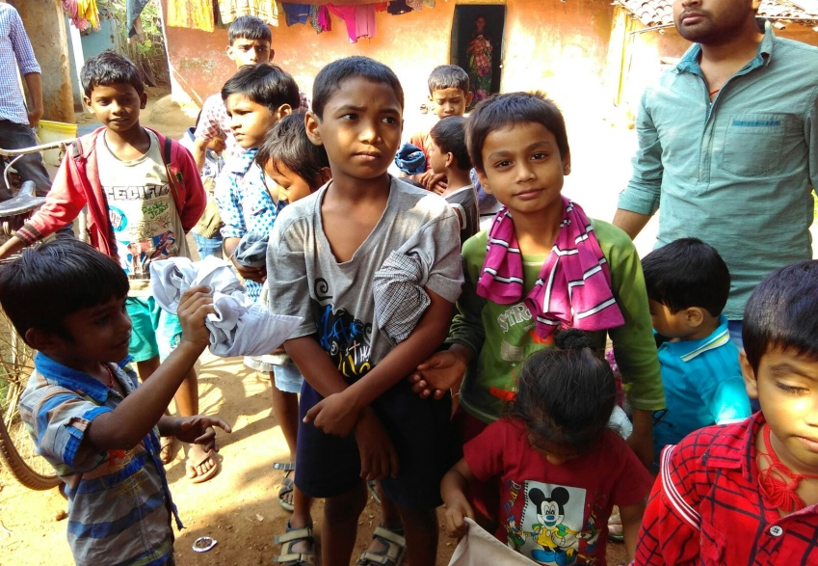
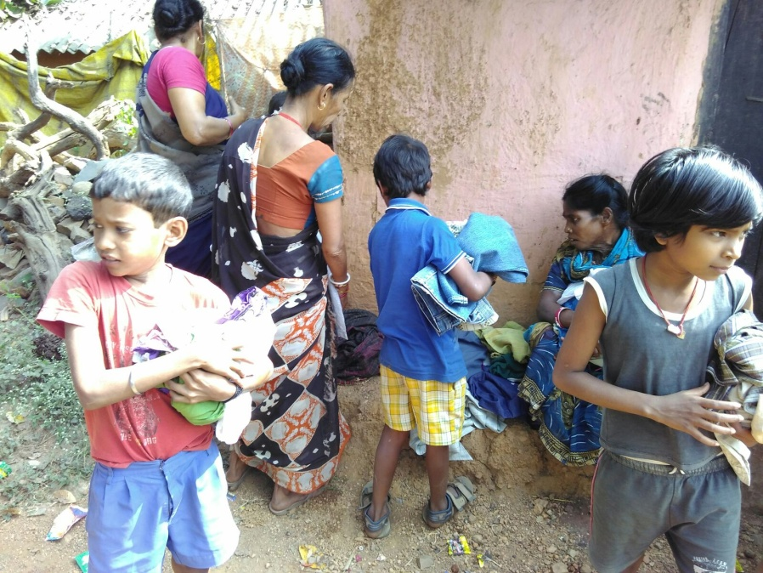
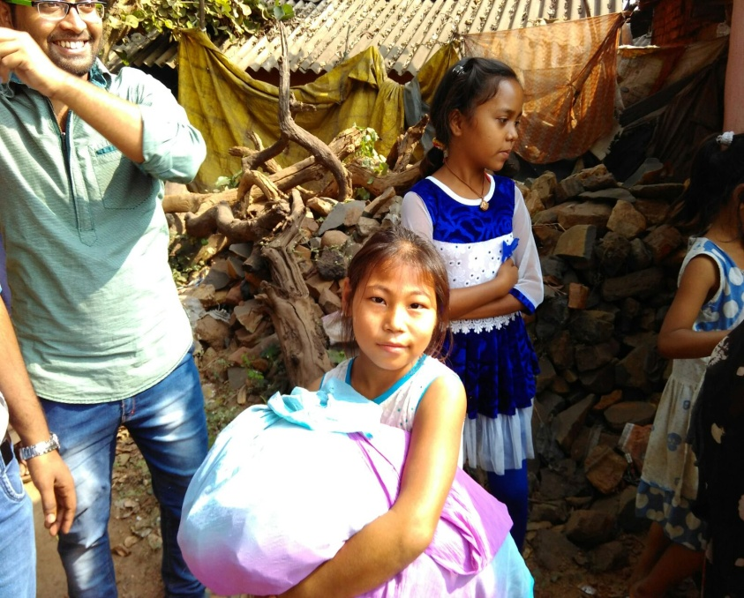

Slide 9
Come let’s be a part of the noble mission called
The Joy of Giving because

Slide 10
EASY WAY TO DONATE NOW
You can donate at any our centres by just making a call to Sankalp-A Pledge to Change volunteers.
All our centres are Adityapur based and run 6 days a week
You may donate books from
Class 1-8- Course Text Books (Any Board)
Story Books
Unused stationery
Any other items like bag, toys, uniforms etc.
Relevant Contact Nos. Are
Subodh Kumar Das-9798756336
Mayank Aggarwal -9031975746
Suresh Pareek -7209632032
Vikas Dixit -9472706225

Slide 11
ACCOUNT DETAILS FOR SUPPORT
Sankalp Account Details
You can transfer funds online into our account:-
“SANKALP” A/C No.-31114719936
CIF No: 85757412911
IFSC Code: SBIN0001882
MICR Code: 831002004
Branch code: (1882)
Branch: SBI- RIT JAMSHEDPUR
You may also visit our website and pay through online link available over it.
www.sankalpnitjamshedpur.org

Slide 12
“You have not lived today until you have done something for someone who can never repay you.”
Thank You
www.sankalpnitjamshedpur.org

